Slide 1
Fire Risk Awareness in the Home
Vulnerable People
London Fire Brigade
Station Commander Paul Anstey
Notes:
NOTE TO PRESENTER
The accompanying Quick Reference Guide should be given to the carers at the start of the session.
Ideally this presentation should form the major part of a structured training event for carers.
Ideally a break should be provided before the case studies are read in order to enable the attendees to discuss the information provided to that point.
The presenter may add their name to the first slide but the rest of the presentation should remain as issued.
This presentation is designed to help those people who are working directly with vulnerable people to identify those who may be at a high risk of having a fire, or being injured or killed.
The presentation includes pictures from real incidents.

Slide 2
The majority of people who are fatally or seriously injured in fires have common vulnerabilities and risk factors.
They are often known to service providers and agencies. It’s the responsibility of us all to reduce these risk where we can and help prevent fires from happening
Notes:
Note to presenter: Give audience time to read these statements
Too many fire fatalities show obvious signs of a higher risk of fire that were missed by carers and family. Care needs often increase with time and so does fire risk.
This presentation is designed to help care partners recognise fire risk to their clients and work with the London Fire Brigade to reduce risk.

Slide 3
A third of people who are seriously or fatally injured by a fire were getting some form of care.
Formal
Social workers
Occupational
Therapist
Paid Carer
Clinicians
Informal
Neighbour
Family Member
Friend

Slide 4
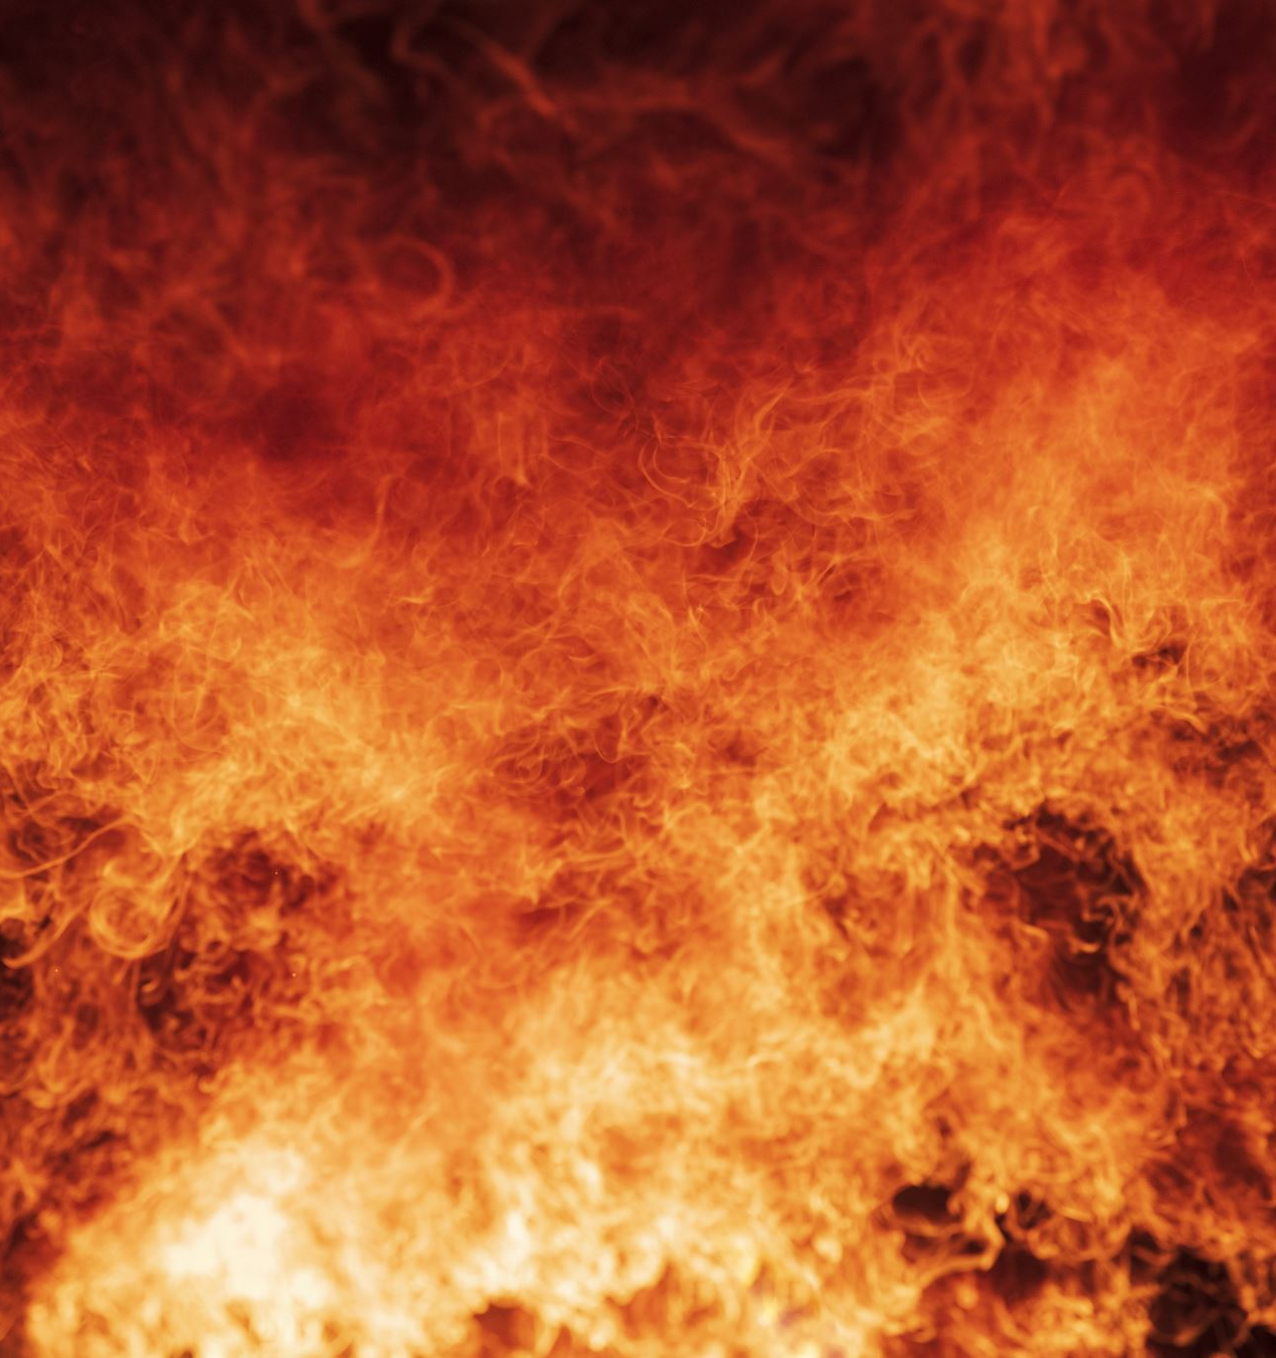
These fires occurred in a place where people should be and feel safe – in their own homes

Slide 5
Aim
To raise awareness amongst the care community of the
characteristics and behaviours that increase fire risk for
vulnerable people, and the action they can take to
reduce that risk.
Objectives
To be able to identify individuals at a high risk of
having a fire
To be able to recognise high fire risk factors
Tell you what actions to take to help reduce risk
To know what to do in the event of a fire
Notes:
The aim of this presentation is to assist carers in identifying vulnerable people who are at a greater risk of fire, know what to do with that information and the steps needed to reduce the risk. They will also be able to explain what to do in the event of a fire.
Fires can be devastating. Some people have a higher than average likelihood of falling victim to accidental fires. Many of these people may be known to, or come into contact with, professionals and volunteers from a wide variety of services and agencies.
The London Fire Brigade targets our risk reduction work at individuals who are at a greater risk of fire. We work with other services and agencies to ensure that fire safety advice is given and steps are taken to reduce fire risk.

Slide 6
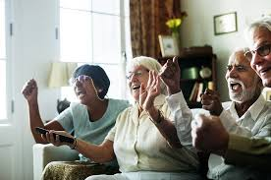
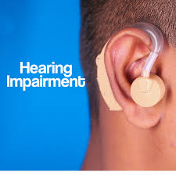
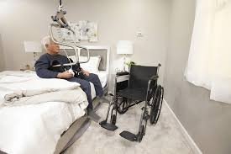
Extra Consideration
LEARNING
DIFFICULTIES
DEMENTIA
Notes:
Fires can be devastating for anyone ,but for people who are Older people, people with disabilities, people with visual and hearing impairments, and people who are vulnerable for other reasons all need careful consideration when it comes to fire safety. There are 4 main reasons why:
They may not be able respond to a fire as quickly.
They may not be able to escape a fire.
They may be more at risk due to lifestyle factors.
They may use healthcare equipment such as oxygen or emollient creams that are flammable.
Or who have conditions affecting their understanding such as…… there ability to react to or escape can be significantly reduced
Many of these people will be known to you or come in contact with professional and volunteers from a wide variety of agencies and services

Slide 7
They may not be able respond to a fire as quickly. They may not be able to escape a fire. They may be more at risk due to lifestyle factors. They may use healthcare equipment such as oxygen or emollient creams that are flammable.
Reasons for Increased
Fire Risk
Notes:
They may not be able respond to a fire as quickly.
They may not be able to escape a fire.
They may be more at risk due to lifestyle factors.
They may use healthcare equipment such as oxygen or emollient creams that are flammable.

Slide 8
An increased risk of fire from
Ability to respond
and Escape
Smoking
Hoarding disorder
Electrical sockets overloaded
Signs of unsafe wiring
Unsafe use of candles and naked flames
Cooking left unattended
Evidence of previous fire or near misses
There have been incidents (or threats) of arson.
Notes:
Let look more in depth
Increased risk of fire
Reduced ability to react to a fire
Reduced ability to escape from a fire
Burns or scorch marks from cigaerretys
is someone you care for at greater risk from fire?
Let's take a closer look at the of health and lifestyle factors that increase a person's vulnerability to fire risk.
Less able to react if there's a fire
These factors might mean a person might not be able to react as quickly in the event of a fire.
There are no working smoke alarms installed, or there isn't a smoke or heat alarm in every room where a fire might start.
The person has a history of alcohol dependency or drug misuse (prescribed or recreational).
Mental health conditions such as dementia or learning difficulties.
Physical health issues including sensory impairments, such as hearing or sight.
The property is not meant to be used for sleeping accommodation and fire safety features like fire doors and alarms haven't been fitted.
Reduced ability to escape a fire
Some people might not be able to escape a fire as quickly as other, due to factors such as:
Reduced mobility due to a physical disability, age-related problems or as a result of a long-term illness.
Escape routes are not kept clear, or are blocked – hoarding disorder may be a factor.
Conditions that affect decision-making.
If you know or work directly with anyone who has any combination of the risk factors, please encourage them to arrange a free home fire safety visit. Visits can be arranged at any time (24/7), and specialist alarms can also be fitted – for example, strobe light and vibrating pad alarms for those who are deaf or hard of hearing.
If any of these signs are combined with limited mobility – for example, if the person you care for is bed bound or spends most of their time in a chair – the person is particularly at risk. It's important to make sure appropriate measures are taken so they know what to do in the event of a fire in their home, and react appropriately.

Slide 9
Residents will be less able to react
to a Fire if
There are no working smoke alarms installed, or there isn't a smoke or heat alarm in every room where a fire might start.
The person has a history of alcohol dependency or drug misuse (prescribed or recreational).
Mental health conditions such as dementia or learning difficulties
Physical health issues including sensory impairments, such as hearing or sight.
The property is not meant to be used for sleeping accommodation and fire safety features like fire doors and alarms haven't been fitted.
Notes:
These factors might mean a person might not be able to react as quickly in the event of a fire.

Slide 10
Reduced ability to
escape from a Fire
Due to a physical disability, age-related problems or because of a long-term illness.
Escape routes are not kept clear or are blocked – hoarding disorder could be a factor.
Conditions that affect decision-making.
If any of these signs are combined with limited mobility – for example, if the person you care for is bed bound or spends most of their time in a chair – the person is particularly at risk. It's important to make sure appropriate measures are taken so they know what to do in the event of a fire in their home and react appropriately.
Notes:
Some people might not be able to escape a fire as quickly as other, due to factors such as:
if you know or work directly with anyone who has any combination of the risk factors, please encourage them to arrange a free home fire safety visit. Visits can be arranged at any time (24/7), and specialist alarms can also be fitted – for example, strobe light and vibrating pad alarms for those who are deaf or hard of hearing.
If any of these signs are combined with limited mobility – for example, if the person you care for is bed bound or spends most of their time in a chair – the person is particularly at risk. It's important to make sure appropriate measures are taken so they know what to do in the event of a fire in their home, and react appropriately.
Learn more about escape plans from homes here, and from workplaces (like residential care homes) here.

Slide 11
Health Care Equipment
Home oxygen therapy (oxygen cylinders and portable units)
Dynamic airflow pressure relieving mattresses and overlays
Incontinence products (pads and underwear)
Health care equipment and products used in the home allow people to be cared for in familiar surroundings. It's important that this equipment is used as prescribed and provided by a medical professional as these items can ease discomfort and improve quality of life.
However, it's also important to be aware that in the event of a fire they may increase the spread and intensity of the fire. On this next pages, we talk about how to reduce fire risk when using/caring for someone who uses:
Notes:
Health care equipment and products used in the home allow people to be cared for in familiar surroundings. It's important that this equipment is used as prescribed and provided by a medical professional as these items can ease discomfort and improve quality of life.
However it's also important to be aware that in the event of a fire they may increase the spread and intensity of the fire. On this page, we talk about how to reduce fire risk when using/caring for someone who uses:
How can specialist healthcare equipment be used safely?
If you care for someone who needs specialist healthcare equipment, or use this type of equipment yourself, make sure that you always follow the manufacturer's safety advice. Let's take a look at different kinds of equipment in a little more detail...
Home oxygen therapy
Understanding the risks
Used by people with severe respiratory conditions, oxygen therapy provides air that contains more oxygen than normal. Specialist equipment (which can include cylinders and portable units) is used to pipe medical oxygen through either a nasal cannula or face mask to the patient.
Unfortunately though, the addition of concentrated oxygen into the room or surrounding environment will greatly increase the intensity of a fire should one start.
Smoking or the use of any naked flames (such as candles, fires and cooking) anywhere near oxygen is extremely dangerous and increases the risk of significant injury in the event of a fire.
Fire safety advice
Never smoke or let anyone else smoke nearby whilst using oxygen equipment. This includes e-cigarettes and their chargers.
Do not use matches or any naked flames (such as candles, incense sticks or oil burners, gas stoves, portable or open fires) where oxygen equipment is used.
Make sure oxygen is turned off when not in use.
Dynamic airflow pressure relieving mattresses and overlays
Understanding the risks
These items are used for the prevention and treatment of pressure sores and ulcers that can be caused by extended periods of immobility. The mattress is filled with air by a pump which adjusts pressure according to the patient’s needs.
When punctured by any heat source (e.g. a cigarette or match) the escaping air can cause a fire to spread rapidly. The emergency back up battery may also continue to pump air, which can cause the fire to burn longer and with greater intensity.
Fire safety advice
Never smoke near an airflow mattress, or let the person you care for smoke in bed.
Keep ignition sources (such as matches, cigarettes, candles, incense sticks or oil burners) away from airflow mattresses.
Never use an electric blanket on an airflow mattress.
Ensure that electrical equipment is well maintained and kept a safe distance from airflow mattresses.
Keep fires and heaters away from airflow mattresses.
Never charge electrical items or place anything hot (such as hair straighteners or hairdryers) on an airflow mattress.
Incontinence products
Understanding the risks
These are often supplied in large quantities to people who have continence problems. They contain plastics and other chemicals, in addition to paper or textile padding which provide additional fuel to a developing fire.
Fire safety advice
Never smoke or allow others to smoke close to stored incontinence products
Always store incontinence products safely away from anything that has a flame or is likely to get hot, for example heaters, candles, fires, chargers and other electrical appliances
Try not to store the supplies all in one place – ideally not next to the person’s bed or chair

Slide 12
Home oxygen therapy
Understanding the risks
Used by people with severe respiratory conditions, oxygen therapy provides air that contains more oxygen than normal. Specialist equipment (which can include cylinders and portable units) is used to pipe medical oxygen through either a nasal cannula or face mask to the patient.
Unfortunately, though, the addition of concentrated oxygen into the room or surrounding environment will greatly increase the intensity of a fire should one start.
Smoking or the use of any naked flames (such as candles, fires and cooking) anywhere near oxygen is extremely dangerous and increases the risk of significant injury in the event of a fire.

Slide 13
Fire safety advice
Never smoke or let anyone else smoke nearby whilst using oxygen equipment. This includes e-cigarettes and their chargers.
Do not use matches or any naked flames (such as candles, incense sticks or oil burners, gas stoves, portable or open fires) where oxygen equipment is used.
Make sure oxygen is turned off when not in use.

Slide 14
Dynamic airflow pressure relieving mattresses and overlays - Understanding the risk
These items are used for the prevention and treatment of pressure sores and ulcers that can be caused by extended periods of immobility. The mattress is filled with air by a pump which adjusts pressure according to the patient’s needs.
When punctured by any heat source (e.g. a cigarette or match) the escaping air can cause a fire to spread rapidly. The emergency back-up battery may also continue to pump air, which can cause the fire to burn longer and with greater intensity.
Fire safety advice
Never smoke near an airflow mattress or let the person you care for smoke in bed.
Keep ignition sources (such as matches, cigarettes, candles, incense sticks or oil burners) away from airflow mattresses.
Never use an electric blanket on an airflow mattress.
Ensure that electrical equipment is well maintained and kept a safe distance from airflow mattresses.
Keep fires and heaters away from airflow mattresses.
Never charge electrical items or place anything hot (such as hair straighteners
or hairdryers) on an airflow mattress.

Slide 15
Incontinence products
Understanding the risks
These are often supplied in large quantities to people who have continence problems. They contain plastics and other chemicals, in addition to paper or textile padding which provide additional fuel to a developing fire.
Fire safety advice
Never smoke or allow others to smoke close to stored incontinence products
Always store incontinence products safely away from anything that has a flame or is likely to get hot, for example heaters, candles, fires, chargers and other electrical appliances
Try not to store the supplies all in one place – ideally not next to the person’s bed or chair

Slide 16
Emollient Skin Creams Understanding the risk
Used for Eczema, Bed Sores, Psoriasis, Ulcers
Fire Safety Advice
Loose clothing can easily catch fire – take care not to lean over a hot hob and roll up your sleeves, if possible, when cooking.
Don’t Smoke
Keep candles away from your/their clothing, including when lighting them.
Sit at least one metre away from a heater – sitting too close could easily set light to your clothes or chair. Always follow the manufacturer’s instructions.

Slide 17
How to give the best
possible care?
Keep your eyes open – burns marks on clothes or furniture are often ignored – they are near misses! The next time they could lead to a fire and death.
Be responsible. You are their carer/visitor and may be the only person who sees the fire risk.
Recognise the risk. The case studies in this presentation are just a few of the many cases where fire deaths occur because people have not recognised fire risk.
Act. Your actions could save a life. If you’re not sure what to do tell your line manager so they can act or give advice.
Notes:
Recognise the risk. The case studies in this presentation are just a few of the many cases where fire deaths occur because people have not recognised fire risk. Fire Kills!
Keep your eyes open – burns marks on clothes or furniture are often ignored – they are near misses! The next time they could lead to a fire and death.
Be responsible. Your are their carer and may be the only person who sees the fire risk.
Act. Your actions could save a life. If you’re not sure what to do at the very least tell your line manager so they can take action.
Carers have access on a daily basis to people’s homes and living spaces. They play a vital role in the assessment of high risk individuals, spotting signs of risk, and notifying line management of any concerns. Reporting concerns to a manager enables them to take swift and appropriate action to ensure people’s safety and ultimately meet the obligations of the Care Certificate.
The following slides will show you how to recognise some of the characteristics/behaviours that;
Increase the probability of having a fire
Decrease the ability to react and respond to a fire alarm or fire
Decrease the ability to escape from a fire

Slide 18
Hoarding
Hoarding is where someone acquires an excessive number of items and stores them in a sometimes-chaotic manner. The items can be of little or no monetary value and usually result in unmanageable amounts of clutter.
How can you reduce fire risks for hoarders?
Use LED Flameless Candles
Check central heating or show them
how to use portable heaters properly
Stop using portable heaters, candles and gas hobs to heat home
Contact local authority to
help clear some clutter
Change smoking habits, use ashtrays
Smoke outside, never smoke in bed.
Develop an escape plan
Book a home fire safety visit – a free service we offer to share advice and help.
Notes:
Understanding and reducing the risks
How can you reduce fire risks for hoarders?
Because of the amount of possessions, exit routes can become blocked, making safe evacuation more difficult. Fires can also spread much faster, especially where there are flammable items such as newspapers or cardboard.
Understand the risks
Hoarded materials can easily catch alight if they come into contact with heat sources such as overloaded extension leads, the kitchen hob or naked flames like candles or cigarettes. Because of the amount of possessions, fires will also spread much faster.
Fire safety suggestions
If you care for someone who lives in home that has become hoarded, you can help them live more safely by:
Encouraging them not light candles or tea lights of any kind. A safer option is to use LED flameless candles.
Ensuring they have appropriate heating so that they are not using portable heaters, candles or gas hobs to heat the home. If using portable heaters, ensuring that items aren't placed on top of, or too close to them.
Suggest – or if you can, make sure – that they smoke outside if they are a smoker, never smoking in bed or where they could fall asleep, and that they use proper ashtrays.
Contacting the Local Authority to discuss options for support to clear some of the clutter.
Work with them to develop an escape plan.
Book a home fire safety visit – a free service we offer to share advice and help.

Slide 19
The consequences for your client could be devastating.
They may:
Lose their property and possessions
Have to leave their home
Suffer life changing injuries such as burns
Be Fatally Injured
What could happen
if I don’t report my concerns?
Notes:
It is your duty under the Care Certificate to promote fire safety and act upon fire risks.
If you don’t report concerns, the consequences for your client could be:
Loss of their property and possessions
Having to leave their home
Suffering from life changing injuries such as burns or respiratory damage
Death as a result of a preventable fire
There is also the potential for legal action against those responsible for their care.

Slide 20
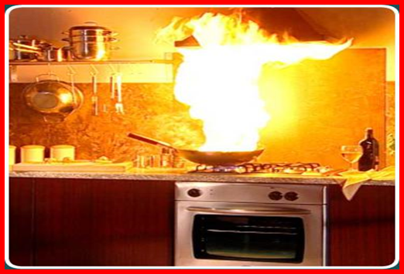
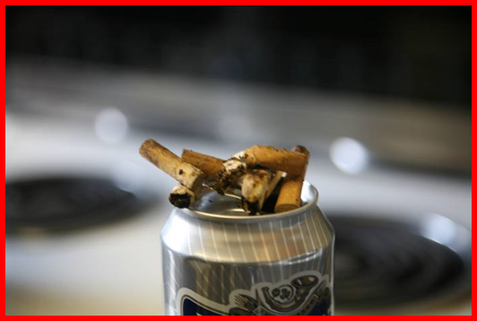
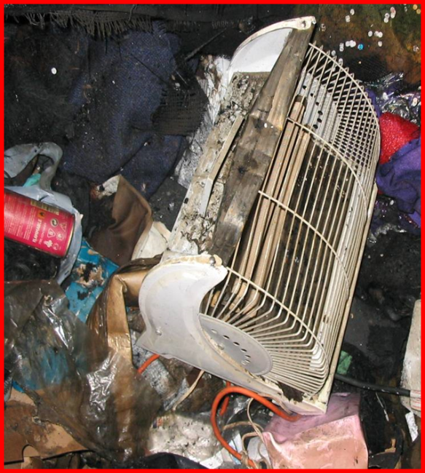
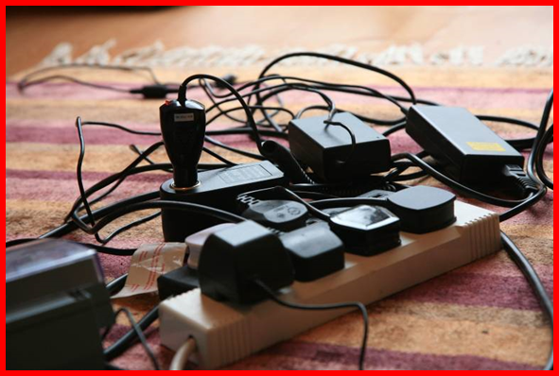
Risk of having a fire
Unsafe smoking
Unsafe cooking
Unsafe heating
Overloaded sockets
Misuse of candles
Hoarding
Notes:
Indicators that there's an increased risk of having a fire:
Unsafe smoking such as smoking in bed or on a chair where the person is likely to fall asleep. Discarded cigarettes and matches. Cigarette burns to clothes or furnishings.
Using heaters to dry clothing, towels, etc.
Unsafe cooking such as leaving pans unattended or leaving items on the cooker such as plastic kettles, papers
Overloaded electrical extension leads or sockets with multiple adaptors.
Using portable heaters too close to furniture or furnishings
Hoarding – Hoarded materials can increase fire risk and prevent escape. They are often too close to cookers and/or heaters
Unsafe use of candles – Candles in make-shift holders or on unstable surfaces can fall over and ignite other items.


Slide 21
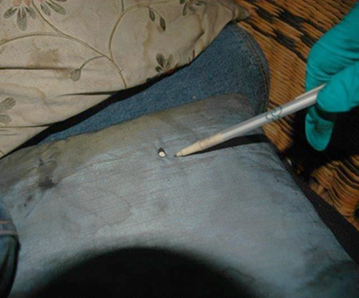
Burn marks on a cushion from careless disposal of smoking materials
Burn marks to floorboards where cigarettes and matches have been carelessly discarded
Notes:
These pictures are from real incidents and show that there was evidence of near misses before the fire.
Image 1 - Burn marks are on floor boards showing clearly where a resident had been throwing cigarettes and matches to the floor whilst still smouldering. This is known as careless disposal
Image 2 - Look for burn marks on furniture, bedding and clothing, evidence of careless disposal of smoking materials

Slide 22
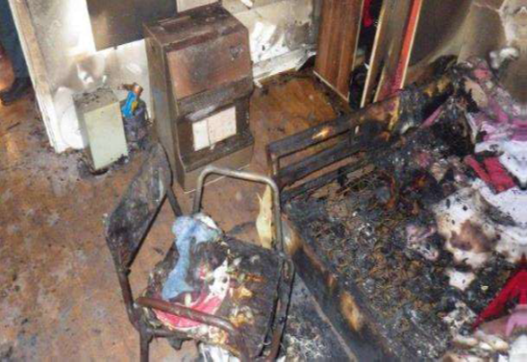
An overloaded cable reel
A heater too close to the bed
Notes:
Overloaded sockets or extension reels generate heat. If cable reel are left coiled this problem is exacerbated.
Heaters too close to clothing or other combustible materials with tragic consequences. Note the clothes hung to dry on a zimmer frame, there is a calor gas portable heater just behind this.
The second picture shows a portable heater that was too close to the bed.

Slide 23
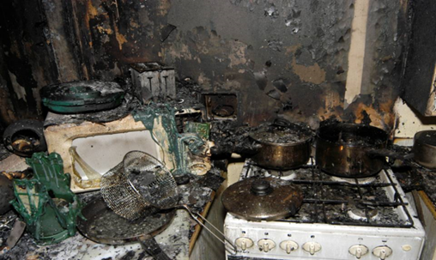
Cooking left
unattended
Electric cooker with the toaster and kettle placed on top of the rings
Notes:
Unsafe cooking is the largest cause of accidental fires - if a client is forgetful, under the influence of alcohol/drugs/medication or falls asleep when cooking the results could be catastrophic.
In the first picture a toaster and kettle have been placed on top of the left hand rings. Turning on these rings could immediately cause a fire.
The second picture shows the result of a pan being left cooking unattended

Slide 24
Characteristics/behaviours that could affect
Ability to respond or escape
Dementia, Alzheimer's disease – cognitive confusion
or forgetfulness
Mental health
Mobility issues e.g. use of walking aid or wheelchair
Previous falls
Being bed or chair bound
Live alone
Illness such as Chronic Obstructive Pulmonary Disease (COPD), Parkinson’s disease, Heart disease, Stroke, Home oxygen user
Drinking alcohol or use of prescriptive or recreational drugs
Sensory impaired e.g. sight or hearing loss
Hoarding
Notes:
Note to facilitator:
Ask candidates why the think the characteristics/behaviours listed could affect the ability to respond or escape. Can they think of any others?
The characteristics/behaviours on this slide considered individually may not constitute a greater risk of fire or injury from fire, but a combination of any of them and/or any of the fire risks on previous slide increases the risk of fire, injury, or death.
For example – a person living on their own does not present any greater risk of experiencing a fire, but if you combine this with being a smoker and bed bound the risk of fire and injury significantly increases.

Slide 25
What is your role?
Recognise fire hazards and signs of previous fires
Take immediate action if possible, to reduce/remove risk
Record and report your concerns to line managers
Contact the fire service for a home fire safety visit as soon as possible
Check the resident’s care plan is up to date and the fire risk is included
Notes:
Under the Care Certificate standards carers have an obligation to promote fire safety in their work setting and understand the ways to prevent fires from starting or spreading.
It is essential that carers are able to identify individuals and take appropriate action immediately in regard to fire risk. As has been demonstrated in previous slides, not acting upon indicators and risk factors can lead to tragic consequences. Check that any actions/interventions that are required as a result of the individual risk assessment are entered onto the resident’s individual care plan e.g. Fire Retardant Bedding (FRB) – along with instructions to ensure that the bedding used is FRB at all times.
Is the client is in their home and you have concerns about fire safety make a referral for a home fire safety visit but do what you can to reduce the immediate risk. In some cases additional control measures may be needed e.g. telecare with linked smoke detection, sprinklers.
If the client is in a care environment such as a care home and you have fire safety concerns raise them with your management immediately.

Slide 26
What are
Home Fire Safety Visits?
LFB will visit the resident in their home and advise on:
Prevention Detection and Escape
The visit may include the fitting of smoke alarms including, in some cases, specialist alarms for the sensory impaired
We can also provide
Flame retardant bedding
Arson Proof letterboxes
Book a home fire safety visit – a free service we offer to share advice and help.
Notes:
A home fire safety visit (HFSV) is an opportunity for the LFB to engage with members of the public, particularly those that are at a higher risk of accidental fires or those that are less able to respond to or escape in the event of a fire occurring. Talking with residents in their own homes enables the Brigade to identify fire risk behaviours/characteristics and provide individually tailored fire safety advice on risk reduction and what to do if there’s a fire.
Carried out by appointment, at the home and at the convenience of the occupier with a relative or carer present if possible.
They cover
Prevention:
Discussion/Survey of property – identifies physical hazards and identifies hazardous behaviours
Advice – on risk reduction (if possible) for the hazards identified
Advice – regarding additional measures such as fire retardant bedding and automatic fire suppressant systems e.g. sprinklers / misting systems
Detection:
Working smoke alarms are essential as they provide vital early warning and allow extra time to escape if there is a fire. They may also alert neighbours to the danger of fire.
Every home should have at least one working smoke alarm per floor, but more may be required to ensure that every room containing a fire risk is covered.
Where telecare is already fitted it should be linked to smoke alarms in all areas of risk.
Strobe light and vibrating-pad alarms are available for those who are deaf or hard of hearing.
If a client is unlikely to react to a fire or fire alarm and/or has limited mobility they may need telecare linked to smoke detection, or a home sprinkler system.
Escape:
Escape Plan– advice on what to do in the event of a fire and how to escape to safety.
Advice on other alternatives if escape is difficult / impossible

Slide 27
Making a Referral
Referrals should be raised through the Home Fire Safety Checker can be found on the Brigade's external website and here
Provide as much information as possible,
This is Assessed across four risks
Risk Category one – (Smoking)
Risk Category two – Increased Risk of Fire
Risk Category three – Less able to react/respond to fire
Risk Category four: Less able to escape from fire

Slide 28
LFB area teams will arrange a visit based on risk with local station, attending crews will raise a safeguarding or welfare concern based on risk found

Slide 29
- ‘A Carers Guide to Home Fire Safety’ that has been developed by the Community Safety Care, Health and Safeguarding team at the London Fire Brigade.
This video has now launched and is live on the London Fire Brigade website for anyone to access and watch. As one of our valued partners, we wanted you to be one of the first to see it.
The video can be found on the SAEB website here:
Fire safety for carers, social workers and support workers | London Fire Brigade
Notes:
Please find the above link to view a Guide to home Fire safety developed by the London Fire Brigade.

Slide 30
Any Questions ?

Slide 31
WORKING TOGETHER
WE CAN SAVE LIVES
Notes:
See the risk
Take immediate action
Tell your line managers about the risk
Refer the client for a HFSV
Consider whether longer term solutions are required such as fire retardant bedding and nightwear, Telecare linked to fire alarms, automatic fire suppression, or even moving the client into a managed environment.
Together we can save lives

